Slide 1
AWS Cloud computing platforms deployment of Landing Zone - Infrastructure as a Code
Team members:
v.kartheeyayini.(211417104109)
S.Madhumitha.(211417104137)
G.Lalitha.(211417104129)
GUIDE: Mrs.C.Jackulin. M.E (ASST. PROFESSOR).
1.V.Kartheeyayini.
2.S.Madhumitha.
3.G.Lalitha.

Slide 2
ABSTRACT
The manual installation and configuration of IT systems has been a tedious and time consuming process that created several challenges to the engineers during the maintenance and management process of the IT systems. The introduction of cloud computing in combination with the rise of the virtualization technology have managed to address some of these challenges. However, these virtualized cloud systems are followed by a huge portfolio of new tools and platforms that are difficult to learn and maintain.
The concept of this project is to create Infrastructure as Code dynamic infrastructure platforms to deploy and manage different applications design like, micro services applications, IOT applications, Legacy Applications etc. So the application needs the infrastructure which supports both legacy and micro services with automations in all environments. The main concept is to move the legacy application to self healing, self management infrastructure cloud environment.

Slide 3
LITERATURE SURVEY
S.NO | TITLE | YEAR | AUTHOR | DESCRIPTION | DRAWBACKS
1 2 | Microsoft, “Azure Resource Manager Overview”, HarshiCorp,“Harshi Corp Terraform”, | Retrieved on 5 August, 2019 Retrieved on 5 August, 2019 | Azure Resouurce Manager HarshiCorp | Azure Resource Manager is the deployment and management service for Azure. It provides a management layer that enables you to create, update, and delete resources in your Azure account. You use management features, like access control, locks, and tags, to secure and organize your resources after deployment. To learn about Azure Resource Manager templates (ARM templates), see the template deployment overview. Terraform allows infrastructure to be expressed as code in a simple, human readable language called HCL (HashiCorp Configuration Language). It reads configuration files and provides an execution plan of changes, which can be reviewed for safety and then applied and provisioned.Extensible providers allow Terraform to manage a broad range of resources, including IaaS, PaaS, SaaS, and hardware services. | Hence, it is not possible to manage all the resources in a single coordinated operation. To deploy, start, configure, or manage every resource individually is time consuming and tedious. ASM lacks control over access of resources. Any user who has access to the cloud service has access to all the resources. No automatic rollback function for incorrect changes to resources Collaboration and security features available only in expensive enterprise plans

Slide 4
S.NO | TITLE | YEAR | AUTHOR | DESCRIPTION | DRAWBACKS
3 4 | Juniper Networks, “Junos OS Overview” The Linux Foundation Projects, “Xen project” | Retrieved on 5 August, 2019 Retrieved on 5 August, 2019 | Junos OS Overview Linux Foundation | Junos OS for the cloud provides a flexible, disaggregated consumption model for network applications. Lightweight, feature-packed, standalone Junos OS is delivered in a Docker container that runs on Linux, allowing you to modularize networking applications and distribute them across a virtual environment. Its open APIs enable third-party application integration. By packaging Junos applications as a Docker container, service providers, cloud operators, and enterprises can deploy Junos container applications in server-based environments to address their unique requirements. Xen Project has led the charge into the area of Unikernels, also called cloud operating systems. These lightweight, special-purpose operating systems are not meant to run on hardware. Rather, they are designed for producing small VMs which can populate massive clouds with minimal hardware. | High costs. Complicated configuration. Hardware design results in slower backbone routing speeds. Proprietary implementation of networking standards can lead to vendor lock-in. less security, more attack surface. Even more attack surface than vSphere.

Slide 5
S.NO | TITLE | YEAR | AUTHOR | DESCRIPTION | DRAWBACKS
5 6 | Opensource.com, “What is Docker” Juniper Networks, “Understanding the OVSDB Protocol Running on Juniper Network Devices” | Retrieved on 5 August, 2019 Retrieved on 5 August, 2019 | Opensource Docker Juniper Networks | Docker is a tool designed to make it easier to create, deploy, and run applications by using containers. Containers allow a developer to package up an application with all of the parts it needs, such as libraries and other dependencies, and deploy it as one package. By doing so, thanks to the container, the developer can rest assured that the application will run on any other Linux machine regardless of any customized settings that machine might have that could differ from the machine used for writing and testing the code. The Junos OS implementation of OVSDB includes an OVSDB server and an OVSDB client, both of which run on each Juniper Networks device that supports OVSDB. The OVSDB server on a Juniper Networks device can communicate with an OVSDB client on an SDN controller. To establish a connection between a Juniper Networks device and an SDN controller, you must specify information about the SDN controller (IP address) and the connection (port over which the connection occurs and the communication protocol to be used) on each Juniper Networks device. After the configuration is successfully committed, the connection is established between the management port of the Juniper Networks device and the SDN controller port that you specify in the Junos OS configuration. | Containers don't run at bare-metal speeds. The container ecosystem is fractured. Persistent data storage is complicated. Graphical applications don't work well. Not all applications benefit from containers. Purchasing the network cabling and file servers can be expensive. Managing a large network is complicated, requires training and a network manager usually needs to be employed.

Slide 6
 | ReplyForward
 | ReplyForward
S.NO | TITLE | YEAR | AUTHOR | DESCRIPTION | DRAWBACKS
7 8 | Digital Rebar ISO 25000, “ISO/IEC 25010” | Retrieved on 24 October, 2019 Retrieved on 30 September | Rackn Digital Rebar ISO Standard Overview | Digital Rebar is self-contained software that runs entirely inside your network. The extensible architecture pulls reusable modules from the our IaC catalog. This allows you to plug in API-integrations & user-extendable workflows that orchestrate multi-vendor infrastructure, giving you cloud-like flexibility. All together, Digital Rebar creates a single control API for your bare metal, virtual, and cloud infrastructure. The quality model is the cornerstone of a product quality evaluation system. The quality model determines which quality characteristics will be taken into account when evaluating the properties of a software product. The quality of a system is the degree to which the system satisfies the stated and implied needs of its various stakeholders, and thus provides value. Those stakeholders' needs (functionality, performance, security, maintainability, etc.) are precisely what is represented in the quality model, which categorizes the product quality into characteristics and sub-characteristics. | Rusting and exposed rebar can reduce the structural strength of concrete; resulting in cracks, weaken foundations and slabs, as well as leaks in basement walls. Self-Discovered Weaknesses. The Weaknesses Discovered by other Researchers.

Slide 7
S.NO | TITLE | YEAR | AUTHOR | DESCRIPTION | DRAWBACKS
9 10 | Openstack, “Attaching physical PCI devices to guests” Oracle, “Virtual Box” | Retrieved on 5 August, 2019. Retrieved on 5 August, 2019 | Openstack Attaching Oracle Virtual Box | The PCI passthrough feature in OpenStack allows full access and direct control of a physical PCI device in guests. This mechanism is generic for any kind of PCI device, and runs with a Network Interface Card (NIC), Graphics Processing Unit (GPU), or any other devices that can be attached to a PCI bus. Correct driver installation is the only requirement for the guest to properly use the devices. Some PCI devices provide Single Root I/O Virtualization and Sharing (SR-IOV) capabilities. When SR-IOV is used, a physical device is virtualized and appears as multiple PCI devices. Virtual PCI devices are assigned to the same or different guests. In the case of PCI passthrough, the full physical device is assigned to only one guest and cannot be shared. VirtualBox is a powerful x86 and AMD64/Intel64 virtualization product for enterprise as well as home use. Not only is VirtualBox an extremely feature rich, high performance product for enterprise customers, it is also the only professional solution that is freely available as Open Source Software under the terms of the GNU General Public License (GPL) version 2. See "About VirtualBox" for an introduction. VirtualBox is being actively developed with frequent releases and has an ever growing list of features, supported guest operating systems and platforms it runs on. VirtualBox is a community effort backed by a dedicated company: everyone is encouraged to contribute while Oracle ensures the product always meets professional quality criteria. | Highly-dynamic range of functions: OpenStack is an open and very dynamic cloud-computing solution. New functions are added regularly, but some other functions can also be removed. Virtual machines are less efficient than real machines because they access the hardware indirectly. Running software on top of the host operating system means that it will have to request access to the hardware from the host. ... A regular computer devoid of virtual machines would then only be affected

Slide 8
TECHNOLOGY STACK
AWS-Amazon Web Services (AWS) is the world’s most comprehensive and broadly adopted cloud platform, offering over 200 fully featured services from data centers globally.
TERRAFORM-Terraform is an open-source infrastructure as code software tool created by HashiCorp. Users define and provide data center infrastructure using a declarative configuration language known as HashiCorp Configuration Language (HCL), or optionally JSON.
JSON-JSON (JavaScript Object Notation, pronounced /ˈdʒeɪsən/; also /ˈdʒeɪˌsɒn/) is an open standard file format and data interchange format that uses human-readable text to store and transmit data objects consisting of attribute–value pairs and arrays
MAKEFILE-In software development, Make is a build automation tool that automatically builds executable programs and libraries from source code by reading files called Makefiles which specify how to derive the target program.
COMMAND PROMPT-A command prompt is the input field in a text-based user interface screen for an operating system or program. A prompt, in this context, is something designed to elicit an action.

Slide 9
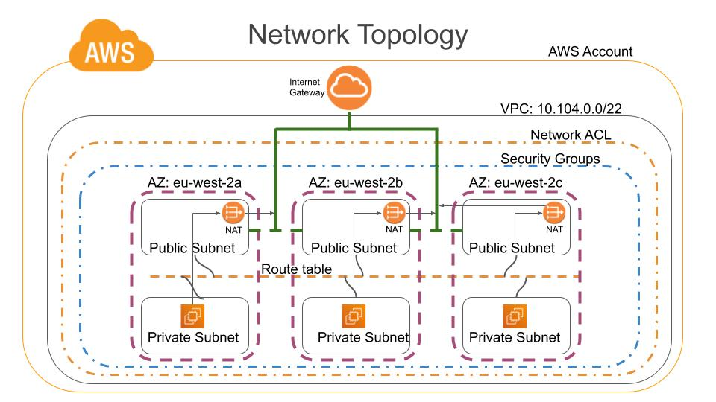
SYSTEM ARCHITECTURE

Slide 10
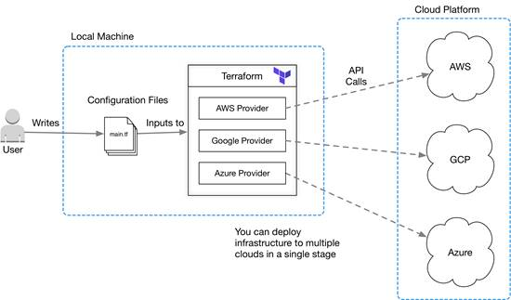
SYSTEM ARCHITECTURE

Slide 11
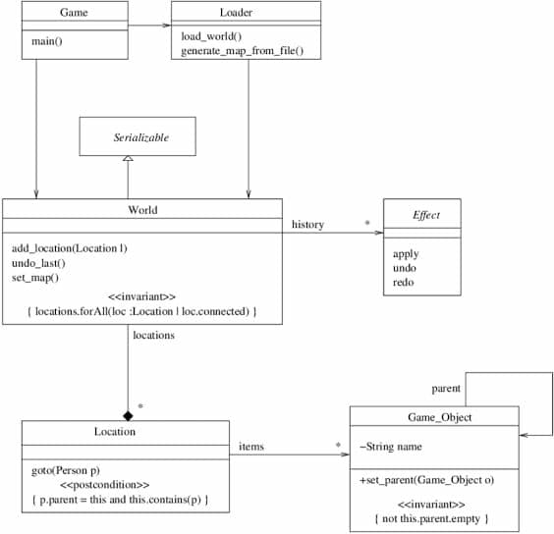
CLASS DIAGRAM

Slide 12
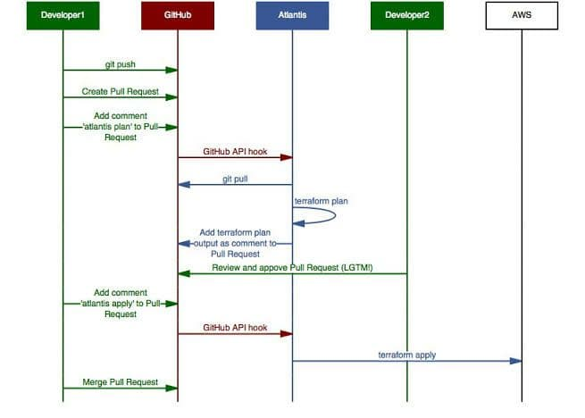
SEQUENCE DIAGRAM

Slide 13
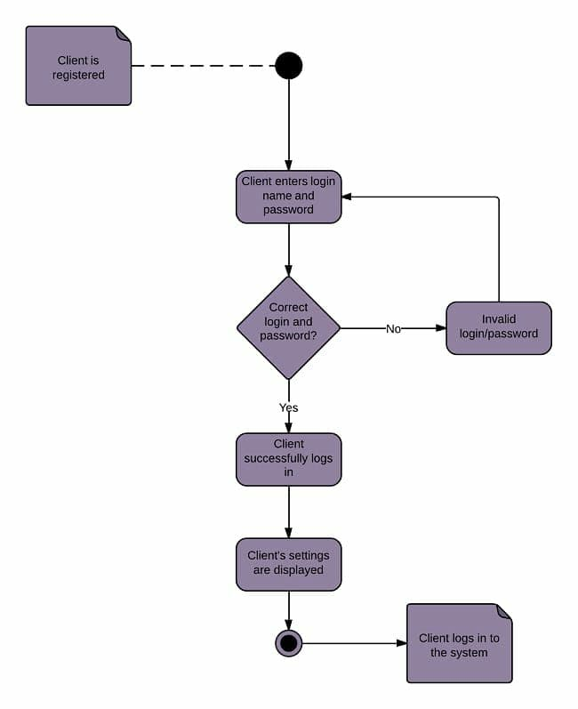
ACTIVITY DIAGRAM

Slide 14
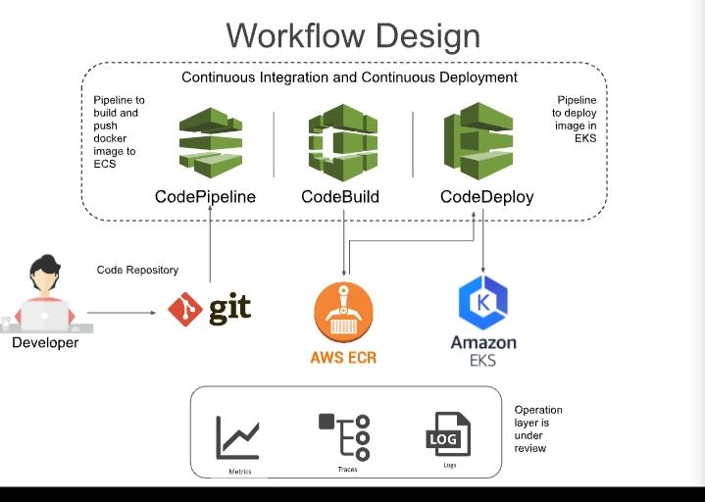

Slide 15
MODULES
Provisioning:
The initial step towards the development of an IT infrastructure is the provisioning of the required components and resources, such as VMs and bare metal machines.

Slide 16
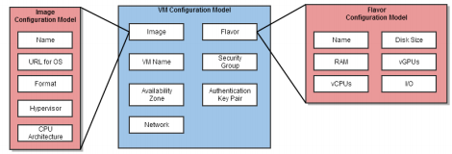
MODULES
Creating Virtual Machines:
Terraform creates VMs [57] in Openstack by combining several resources from the Openstack provider. The user has a wide variety of options for the configuration of an VM instance in Openstack.

Slide 17
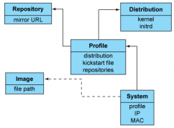
MODULES
Provisioning Bare Metal Machines:
Terraform uses the Cobbler provider [64] to provision bare metal machines. Cobbler performs provisioning by using the PXE standard to boot the machines over the network. works with the Network Interface Card (NIC) of the machine by transforming it to a boot device.

Slide 18
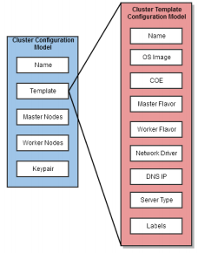
MODULES
Provisioning Containers:
Magnum is the Openstack API service that enables the creation and management of container clusters in Openstack. Magnum offers container orchestration engines (COE) as first class resources in Openstack for the control and management of the clusters.

Slide 19
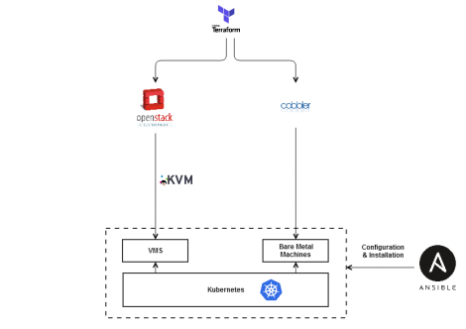
MODULES
Architecture Realization of the Infrastructure Layer:
The purpose of this section is to map the described selected tools from the previous to the generic components described and explain the interconnections between them in order to realize the architecture of the infrastructure layer.

Slide 20
conclusion
The conclusions presented in this chapter have been drawn by examining and answering briefly the research questions that were defined in the first chapter. The limitations and the contributions of this research project are also described in this chapter. Based on the limitations, possible future work and recommendations are listed and analyzed. As we explained, our cloud infrastructure is good for the application deployment, but if it need to cover other areas like data analytics, AI, MI etc., Based on the limitations, possible future work and recommendations are listed and analyzed.

Slide 21
FUTURE ENHANCEMENT
We wanted to extend our project to support multi-business requirements, and we also focus on the new business requirement.
Another key challenge is running across the world. That is managing data sources. The next level of focus would be around data mining.
Further research is required on the overall performance of the system. Thorough insights of the performance of the system can be gained by building a fully functional prototype of the proposed designs with all the necessary hardware and software components and testing the prototype with real world testing environments. Benchmark testing environments can be created that would focus on the performance of the virtual switches, especially on the failover time and the latency.

Slide 22
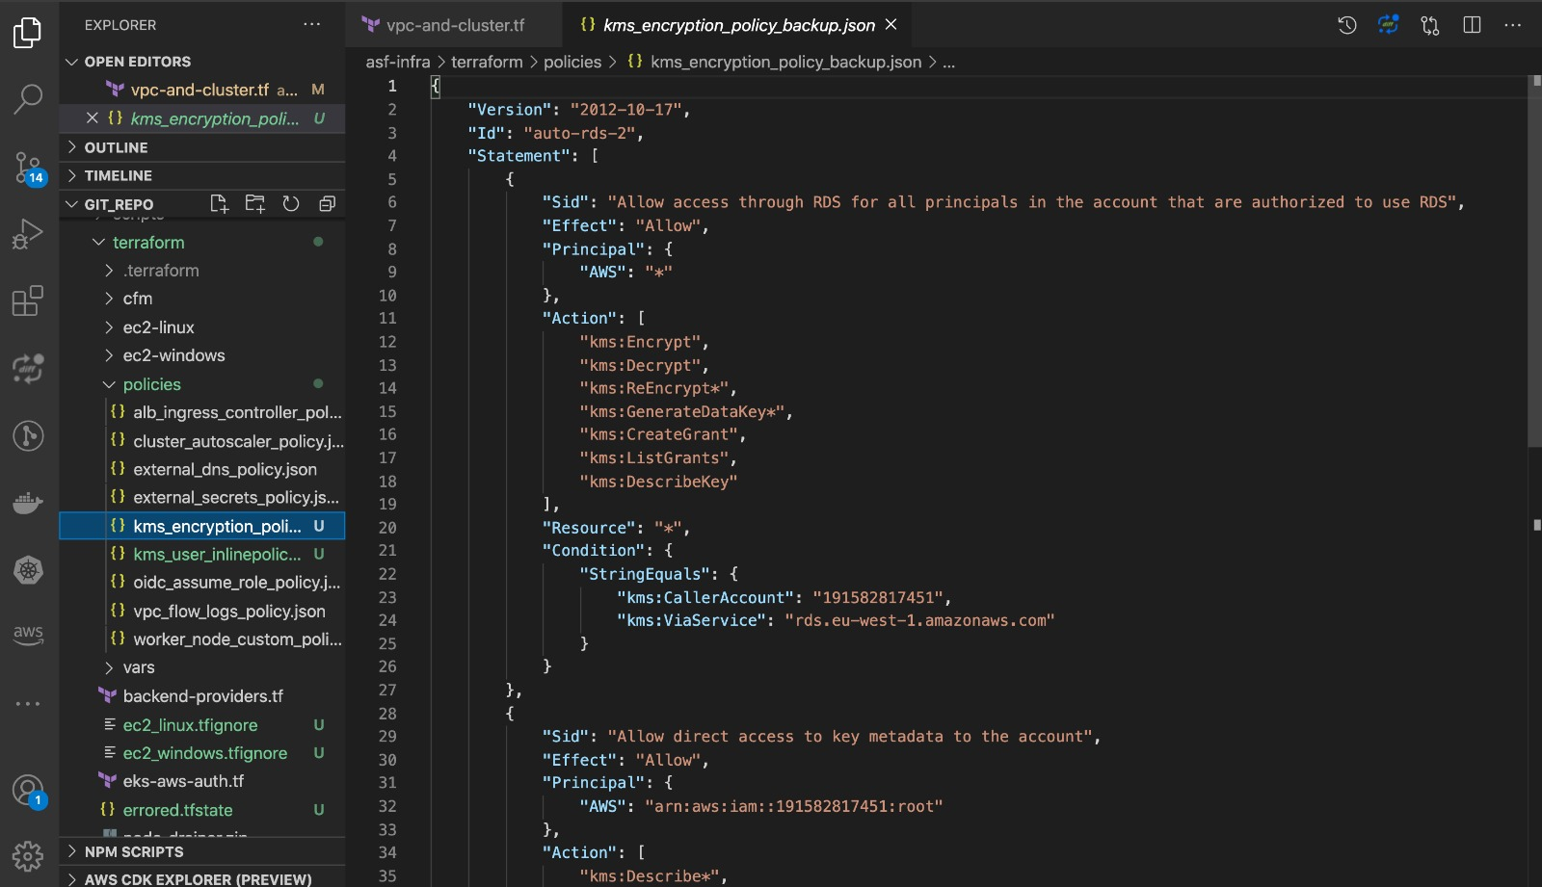

Slide 23
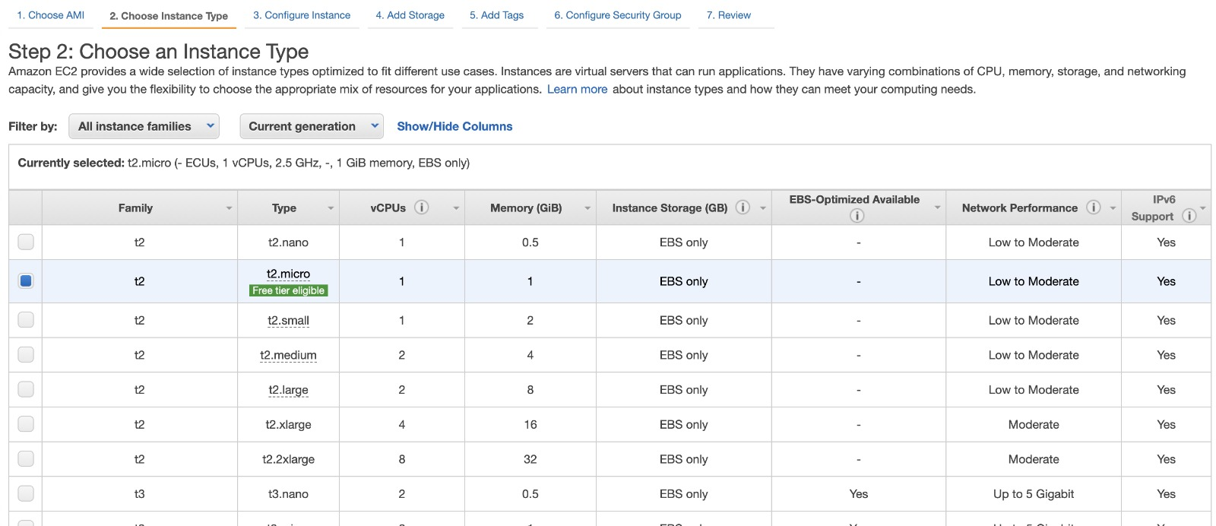

Slide 24
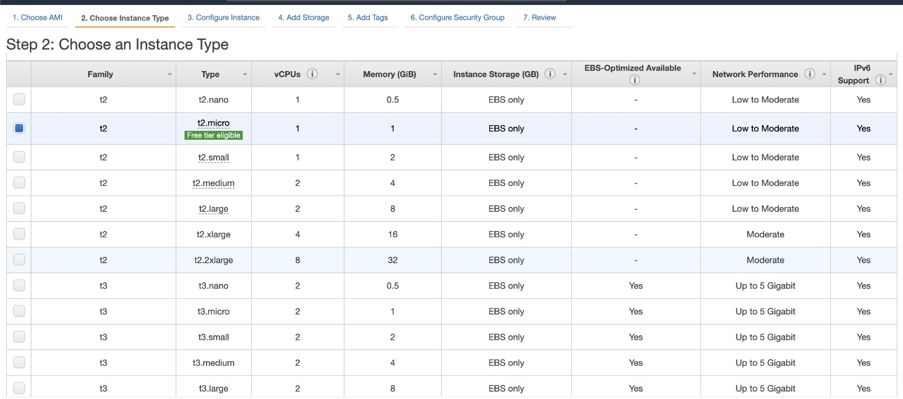

Slide 25
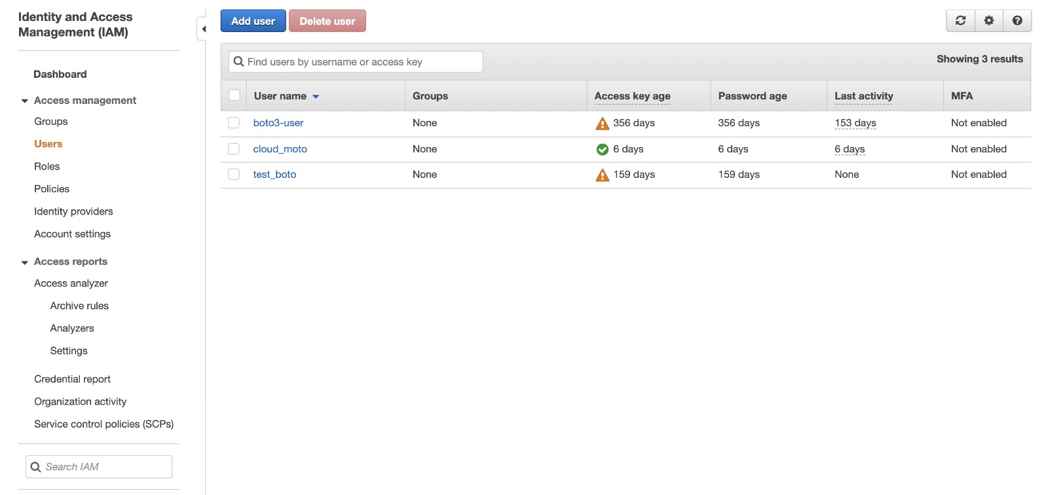

Slide 26
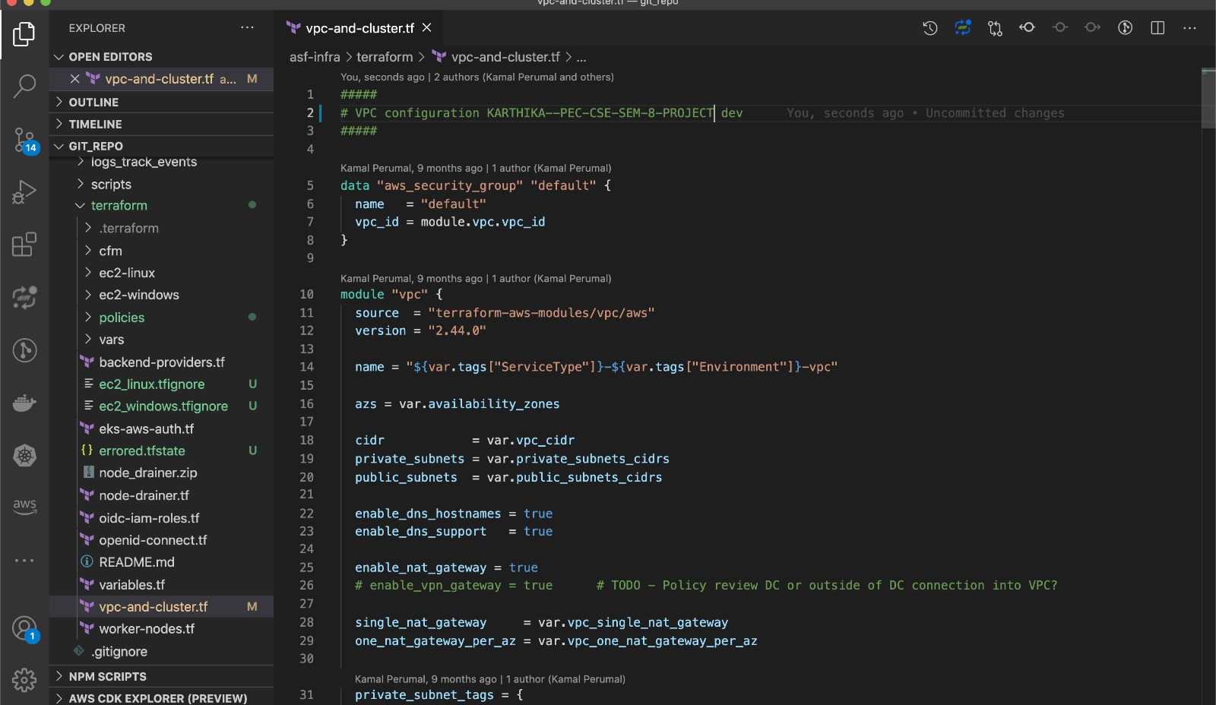

Slide 27
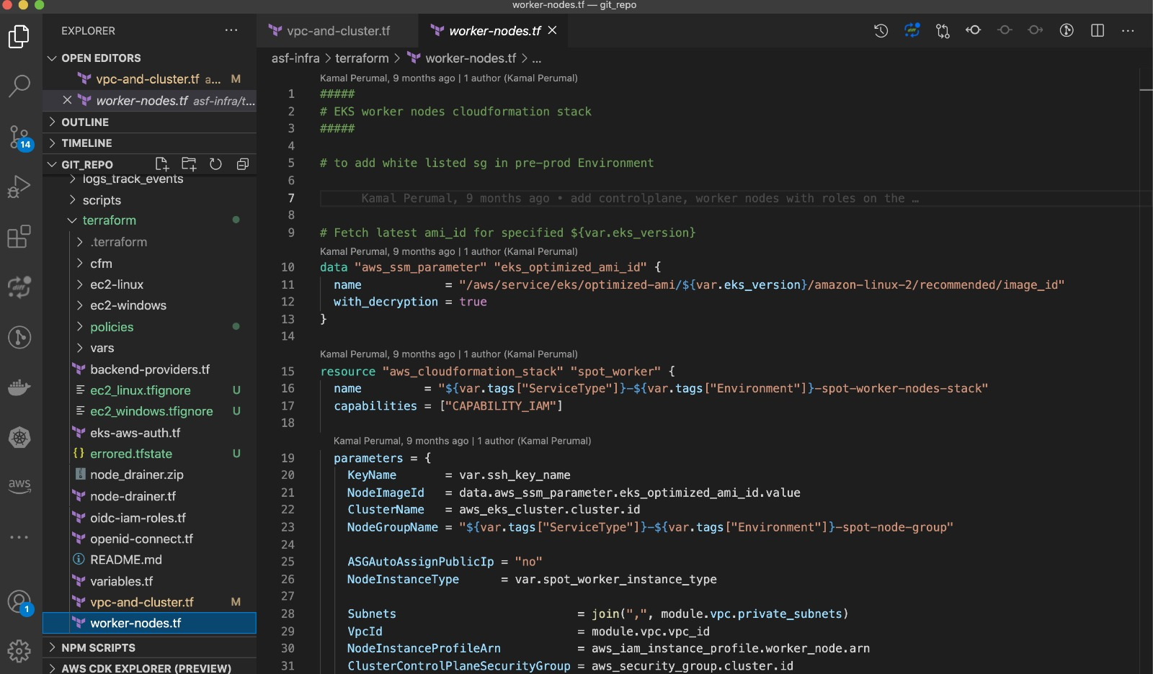

Slide 28
TESTING
VALIDATION TESTING:
The validation of the design follows a qualitative approach, which is the most suitable validation technique for this specific research project, as the rest of the validation techniques are not applicable for this project. Real-world testing of this design was impossible as real-world circumstances could not be reached due to the restrictions of the projects of a mission critical organization. For instance, Thales builds and tests the IT infrastructure on real-world environment such as ships, making real-world testing infeasible in the scope of a Master thesis project. In addition, using this design for solving a real-world problem for a mission critical organization requires additional requirements, which are derived by the needs of their customers and are strictly restricted to specific personnel within the organization.
INTEGRATION TESTING:
Regarding the current proposed design, some experts referred to Cobbler as a functional solution for provisioning bare metal machines, but they would rather have a more modern alternative solution. That is the main reason that convinced most of the participants to select the future design as an improved solution that offers one dynamic platform for provisioning and controlling all infrastructure resources. Using only one tool for provisioning reduces the complexity of the system by reducing the number of software interfaces between the components. Fewer interfaces lead to a system that requires less effort for development and debugging. However, the advantage of this solution is also its main downside according to one of the experts. Controlling everything with one tool (Openstack in this case) creates high dependence on this selected technology.

Slide 29
SYSTEM TESTING:
Testing is performed to identify errors. It is used for quality assurance. Testing is an integral part of the entire development and maintenance process. The goal of the testing during phase is to verify that the specification has been accurately and completely incorporated into the design, as well as to ensure the correctness of the design itself. For example the design must not have any logic faults in the design is detected before coding commences, otherwise the cost of fixing the faults will be considerably higher as reflected. Detection of design faults can be achieved by means of inspection as well as walkthrough.
Testing is one of the important steps in the software development phase. Testing checks for the errors, as a whole of the project testing involves the following test cases:
Static analysis is used to investigate the structural properties of the Source code.
Dynamic testing is used to investigate the behavior of the source code by executing the program on the test data.

Slide 30
REFERENCE
1.Microsoft, “Azure Resource Manager Overview”, Retrieved on 5 August, 2019
2.HarshiCorp, “HarshiCorp Terraform”, Retrieved on 5 August, 2019, .
3.Juniper Networks, “Junos OS Overview”, Retrieved on 5 August, 2019
4.The Linux Foundation Projects, “Xen project”, Retrieved on 5 August, 2019
5. Opensource.com, “What is Docker”, Retrieved on 5 August,
6.Juniper Networks, “Understanding the OVSDB Protocol Running on Juniper Network
Devices”, Retrieved on 5 August
7.Digital Rebar, Retrieved on 24 October, 2019
8.ISO 25000, “ISO/IEC 25010”, Retrieved on 30 September,

Slide 31
9.Openstack, “Attaching physical PCI devices to guests”, Retrieved on 5 August
10.Oracle, “Virtual Box”, Retrieved on 5 August, 2019.

